Slide 1
Summary of Approach and Qualifications
OFCY POC Subcommittee Presentation:
Findings from Community Engagement workshops
April 22, 2021

Slide 2
Community workshops
BRG conducted 4 workshops with community members and leaders to:
Learn about the strengths and needs of Oakland’s youth
Hear directly from groups most impacted by social and economical inequities and inequalities (i.e. Black and Latin families) about their strengths, needs and priorities
Provide a platform to gather community member input that may inform new ideas for OFCY strategies and role
 | Total Participants
TAY Workshop | 13
Provider Workshop | 44
Youth Forum | 55
Parent/Caregiver Workshop | 65
Total | 177

Slide 3
Community workshops – Demographics
Nearly half of all participants were Asian
A majority of participants were immigrants or children of immigrants
Black residents were underrepresented
Majority of participants reside in 94606, 94607, and 94601 zip codes, respectively

Slide 4
Community workshops – Demographics
Nearly half of all participants were as Asian
A majority of participants are immigrants or children of immigrants
Black residents were underrepresented
Majority of participants reside in 94606, 94607, and 94601 zip codes, respectively
 | TAY Workshop | Youth Forum | Parent & Caregiver Workshop | All Workshops
Asian | 2 | 28 | 43 | 73
Middle Eastern | 0 | 10 | 2 | 12
Filipino | 0 | 0 | 1 | 1
Latino | 6 | 6 | 15 | 27
Black | 5 | 11 | 4 | 20
Total | 13 | 55 | 65 | 133

Slide 5
Families named diversity, resourcefulness, and a strong network of community-based organizations as some of Oakland’s unique strengths
Community and Family Strengths
Information sharing
Networks
Community resources
Strong valuing of education
Care for family, friends, and neighbors
“The beauty of our culture is that we share information, and we have a common mentality that we attend community events and model for our children that we want to be a part of change in our community.”
Notes:
There was a strong emphasis on the importance of investing in families. That is, if OFCY wants to support children and youth, they need to support the entire family and engage parents and family members as partners in creating an Oakland where children, youth, and families thrive.
Of note, Immigrant parents said they trust each other, along with schools and community-based organizations, to address the challenges they are facing in their families and communities.

Slide 6
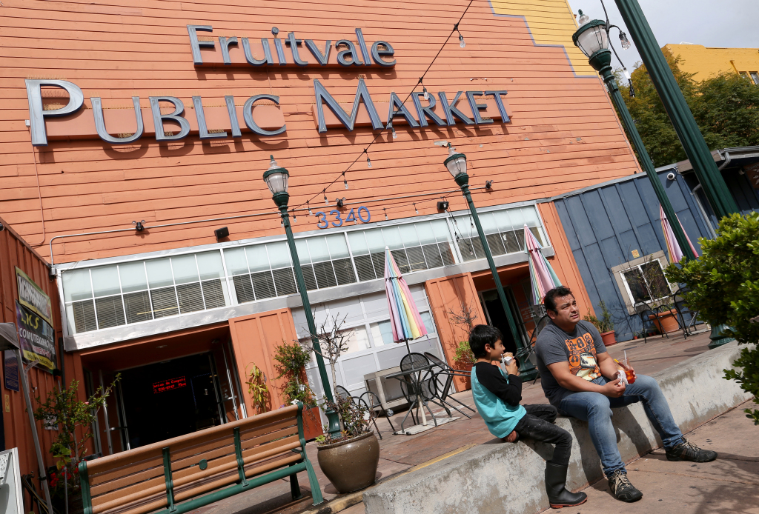
Immigrant families need support accessing and navigating the city’s resources, especially monolingual parents
Parents described Oakland as a community rich with resources for families but found resource navigation to be challenging
Parents reported a strong demand for bilingual resources, parent support, and peer support
Parents use the internet, Facebook, other social media channels, along with friends, family members, schools, and community-based organizations to learn about resources and information
Photo credit: Jane Tyska, Bay Area News Group
Notes:
Many families reported challenges with making ends meet, i.e., paying rent, losing their jobs due to the pandemic, and worrying about having enough food for their families. The parents reported that they had lost their jobs during the pandemic, experienced delays in receiving unemployment payments, and suffered financially
Parents who were part of the essential workforce were navigating the challenges of balancing their need for childcare, income, and supporting their children with remote learning at the same time.
Some participants emphasized that Oakland benefits from a deep well of resources, programs, and benefits that are designed to help low-income families. The challenge, they explained, is that some families do not know that these resources exist or find navigating them with limited English proficiency particularly challenging.

Slide 7
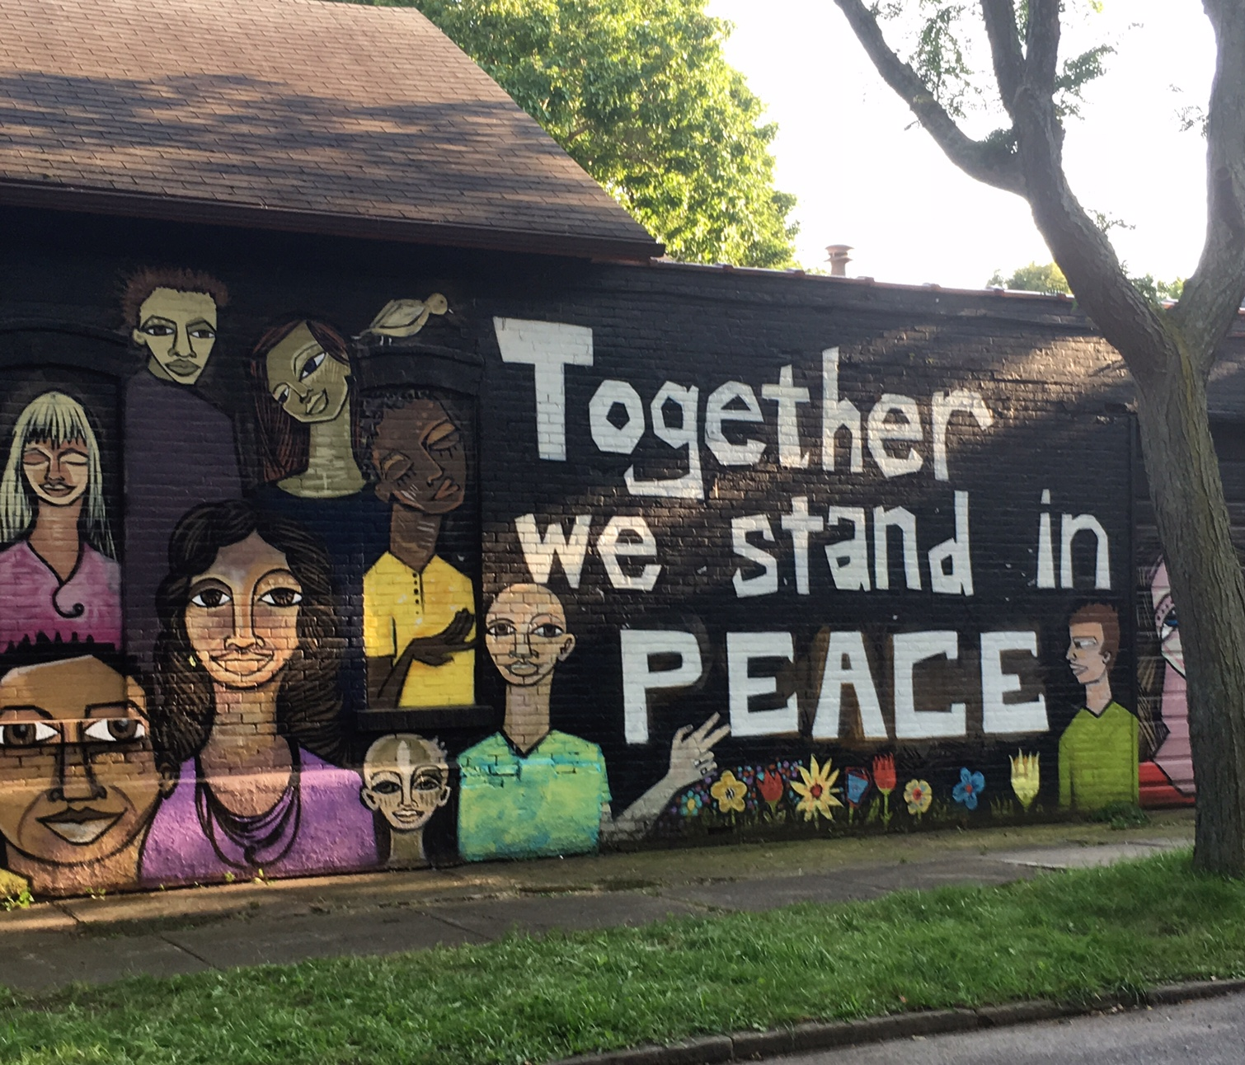
Parents expressed a need for protection, from domestic terrorism, political violence, hate crimes, criminal activity and COVID-19
Immigrant parents expressed their fears of anti-immigrant violence, mass shootings, and hate crimes against people in their families and communities
Many families are feeling socially isolated and worried for the health and safety of their family members
Notes:
Many were concerned about increases in crime in their neighborhoods. That is, immigrant communities are concerned about their physical safety. This fear was highlighted in all breakout groups with parents; coupled with the shelter-in-place mandate and concerns about contracting COVID-19, many families were feeling socially isolated and worried for the health and safety of their family members.
Many attendees felt that that families, neighbors, and community members are strong and best positioned to meet this need for protection, while others looked to law enforcement
One parent highlighted natural community building, information and resource sharing, and care for each other as a particular strength in Oakland and noted that the city should continue to create opportunities for neighbors to build relationships with each other and to advocate for the resources that families need. Some participants also suggested that police, better police response times, and/or neighborhood patrols would make them feel safer.

Slide 8
Parents expressed a wide range of opinions about, perspectives on, and experiences with remote learning and their children’s educational needs
Parents appreciated the opportunity to be more involved in their children’s education
Parents of young children have concerns around their children’s
Kindergarten readiness
Social Development
Lack of physical activity
Parents of older youth would like schools to do a better job at offering learning experiences that prepare young people for the real world- through internships, financial education, and the information and skills they need to function as adults
“My child is entering kindergarten in August. I want to know whether she will be ready for that level.”
Notes:
Families look for a high-quality education, caring teachers, schools that are free from racism, discrimination, and violence, and pathways into higher education.
Immigrant parents, some noted, need help navigating the American educational system, including how to communicate with teachers, advocate for their children, and assess school quality. Many parents believe that they have a key responsibility to learn about how the system works here, to hold high expectations for their children, and to instill the value of education in their families. Some participants suggested that parent-education workshops, family resource centers, and family navigators can support families to help them learn these skills.
Latino parents in particular expressed disappointment with the quality of education available through OUSD. They felt that many schools did not offer a rigorous, college-bound education to their children and that parents were often pushed to enroll them low-quality schools in their neighborhoods by the district. Several had sought out charter schools as an alternative.
Some parents also felt that college was not for everyone and that it really depended on the unique strengths and interests of their children. They emphasized that it is important for their children to have access to education and training programs that prepare them for a living-wage job as opposed to an entry-level job in retail or at Amazon.

Slide 9
Cultural diversity (music, art, and food), the celebration of different traditions, and the city’s history of community organizing around social justice issues were highlighted as Oakland’s greatest strengths
“When there’s injustice, everyone in the community comes together, and I love that.”
Photo credit: Medianews Group /The Mercury News via Getty Images

Slide 10
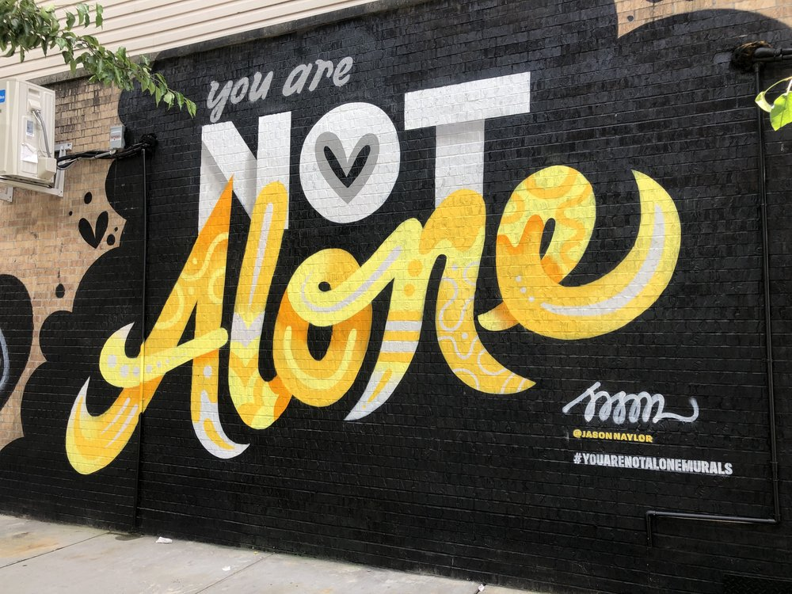
Safe spaces, mental health support, academic support and job placement were the most common systems of support referenced across both youth workshops
Young people want support around mental health concerns including social isolation, stress, anxiety, and depression.
Youth would like schools and the city to do more to raise awareness about opportunities available to youth before they become system involved
Youth reported that they seldomly feel safe outside their homes in Oakland
“Mental health [is important] because it influences other aspects in our lives. Poor mental health leads to poor performance in school, work, and relationships.”
Notes:
Youth emphasized how important it is to have places outside their homes where they can connect with friends and trusted
Several attendees feel that their schools could do a better job of communicating about and connecting them to opportunities that Oakland community-based organizations provide. Youth emphasized the need to provide upstream supports before a young person becomes involved with the juvenile justice system.
Youth said the city and schools need to do more to raise awareness about opportunities available to youth as well as reduce barriers to participating in programs (i.e. stipends, BART/bus fare, place-based programming and programming that occurs before it gets dark outside).
Youth reported that they seldomly feel safe outside – gun violence and fear of being the victim of a crime were the most common reasons youth highlighted; young women feel particularly unsafe at BART and public transit stops

Slide 11
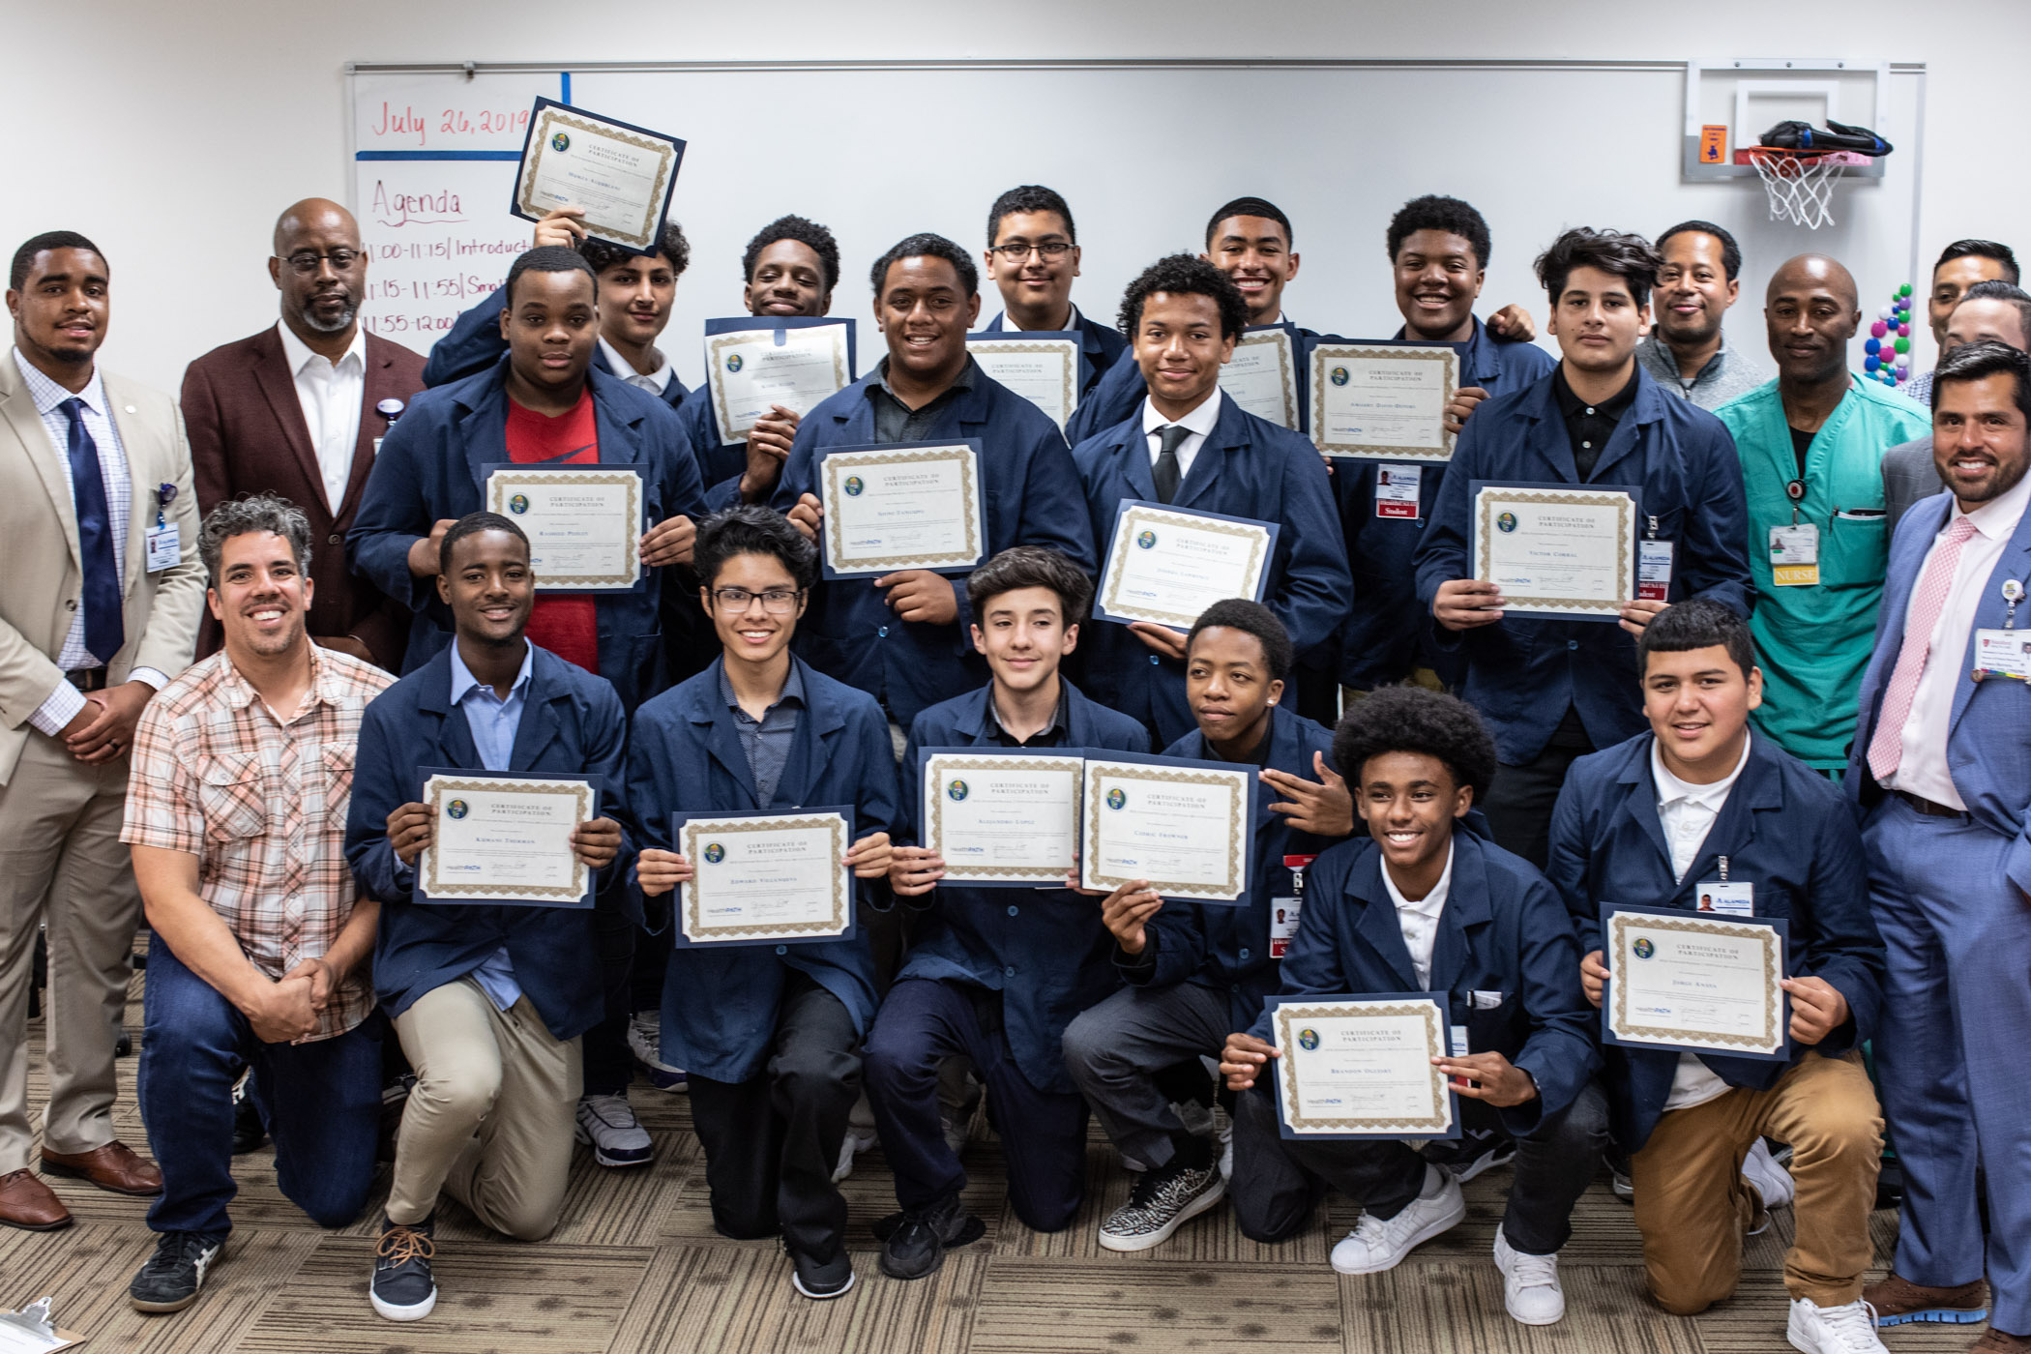
Young people reported challenges with distance learning and educational inequity.
Young people are struggling with distance learning and reported feeling unmotivated due to shelter in place.
Young people were acutely aware of the educational inequities in OUSD,.
Young people enjoy and want hands-on, experiential leadership and career-exploration opportunities, especially in the fields of health, law, and engineering
Photo credit: Alameda Health Systems
Notes:
young people feel like their teachers are overwhelmed and less engaged since they transitioned to virtual learning and spoke of a negative feedback loop in which the absence of having a teacher or mentor to hold them accountable fuels their lack of motivation.
Youth are interested in job training and leadership opportunities that build their resumes, such as internships, research and community service opportunities
They particularly value opportunities based in Oakland with short travel times from their home. Job security and being able to earn a living wage are important factors that young people think about when assessing opportunities and programs.
Financial responsibilities can be barriers to program participation

Slide 12
Providers reported that families are needing support with their basic needs due to the pandemic.
Providers highlighted the challenges families are facing as a result of the pandemic, including the loss of employment, juggling work and remote learning, and an increase in need for housing, food and income
Providers report that language barriers, lack of awareness, and lack of transportation are the greatest barriers to families utilizing Oakland’s resources
Providers highlighted the need for wraparound supports targeting older youth, with a focus on technology, financial education, career preparation, and life skills.
Notes:
Providers are seeing an increase in mental health challenges for both families and youth during the pandemic; Providers see an opportunity for OFCY to create a mental health strategy that focuses on the needs of both youth and families.
- Group therapy, Cognitive Behavioral Therapy (CBT), somatic or holistic therapies, art, peer support and outdoor therapies

Slide 13
Questions

Slide 14
Thank You!
\
Brightstar Ohlson
bohlson@brightresearchgroup.com
Vanetta M. Thomas
vanetta@brightresearchgroup.com
www.brightresearchgroup.com

